Slide 1
UNMANNED MEDICAL WASTE SEGREGATION USING DEEP LEARNING TECHNIQUES
PROJECT GUIDE:
DR. D. NARASHIMAN
TEAM MEMBERS:
PRADEEPA M – 2019115064
SUJA S – 2019115111
VEDHA R - 2019115118

Slide 2
Contents
Introduction
Problem Statement
Literature Survey
Architecture Diagram
Module description
References

Slide 3
Introduction
As the demand for health grows, the increase in medical waste generation is gradually outstripping the load.
Medical Waste contains hazardous, infectious and radioactive substances.
Medical Waste also poses a great threat to the physical and mental health and the quality of life of Garbage Collectors in the hospitals.
To help Garbage Collectors, we propose the Deep Learning approach for recognition and classification of Medical Waste.

Slide 4
Problem Statement
Segregation of medical waste without human intervention using deep leaning technique and robotic arms to safeguard the public health and environment.

Slide 5
Literature Review
S.NO | Title of the paper | Year | Methods/ Approaches used | Pros | Cons | Type of paper
1 | Automatic Bio Medical Waste Segregator. | 2022 | CNN, IOT | Laser pulse from sensor is allowed to travel in all possible directions. Any objects that lie in path of the light will be detected and distance of that obstacle can be measured. | MATLAB approach which lacks real-time processing abilities due to increased processing time and limited speed. | 8th International Conference on Advanced Computing and Communication Systems
2 | An Automated Robotic Arm: A Machine Learning Approach. | 2021 | ML, IOT | Identifies the object with the similarity ratio, distance and angle inclined to the object and arm. Makes use of pressure sensors for accurate picking | Non-portable arm is designed, and can make movable in collecting real time objects. | International Conference on Mobile Networks and Wireless Communications
3 | Implementation of Faster RCNN Algorithm for Smart Robotic ARM Based on Computer Vision. | 2022 | SSD, RCNN, IOT | Segregates blue and red cubes with high precision and accuracy. | Can use Raspberry Pi microcontroller over Arduino UNO. | 6th International Conference On Computing, Communication, Control And Automation

Slide 6
Literature Review
S.NO | Title of the paper | Year | Methods/ Approaches used | Pros | Cons | Type of paper
4 | Automatic segregate: Dry and Wet segregation using CNN(Deep Learning) with Robotic arm. | 2021 | Cloud, IOT, ML | Achieved a 90% accuracy using SVM and 84.96% accuracy using CNN. | Can be made more advanced and efficient by employing a crusher and deep learning. | International Journal of Creative Research Thoughts
5 | Automation of Object Segregation. | 2019 | IOT | Dexter Er2 Robotic Arm are gets actuated using Raspberry Pi 3B+. | Challenging to detect objects at external lighting condition. Collecting objects from conveyor system differs in weight and characteristics. | International Research Journal of Engineering and Technology
6 | Automatic segregation of waste using Robotic Arm. | 2021 | IOT | Automated system and a robotic arm, making it a more effective and efficient system. | Can use deep learning techniques for more accurate prediction. | International Journal of Creative Research Thoughts

Slide 7
About the Dataset
Labels | Sub labels | Format of Image | Total no of images
General Waste | Plastic Bag, Cardboard, Plastic Bottle, Aluminium Tins, Papers | .jpeg,.jpg | 147
Infectious Waste | Bloody bandage, Cotton, Surgical Gloves, Surgical Apron, Mask, Oxygen tube | .jpeg,.jpg | 518
Hazardous Waste | Syringe, IV bag, Tablets, Metals, Glass | .jpeg,.jpg | 158
Radio-active Waste | Radioactive tins and substances | .jpeg,.jpg | 105
Total images |  |  | 928

Slide 8
Phase 1 - Conclusion
The accuracy of the CNN model using SVM is 55%.
The CNN classifier model has a 76% accuracy rate.
The VGG16 model has an accuracy of 90%, which enables the system to recognize and classify the images.
This model was able to predict 90% of data under radioactive correctly and 70% of hazardous data correctly.
Whereas, it could be able to find 60% of infectious data and 50% of general data.

Slide 9
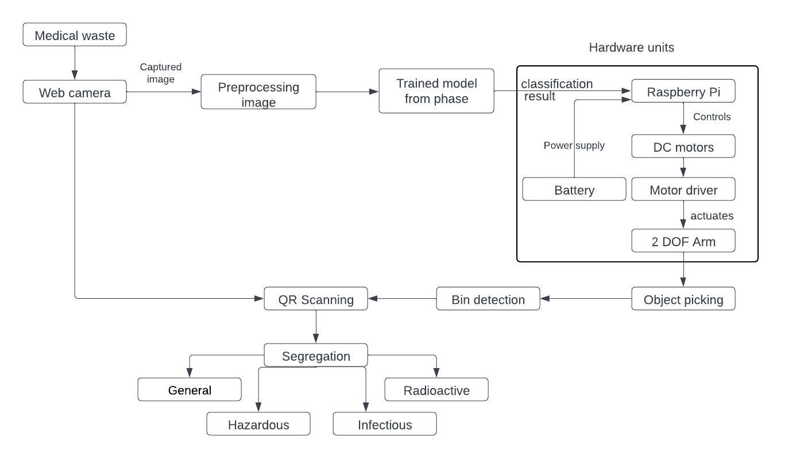
Phase 2 - Architecture Diagram

Slide 10
Modules
Module 1 – Real Time Classification of Medical Waste with background removal
Real time image detection and capturing using web camera.
Using the trained model from phase 1 (VGG 16), classifying the medical waste into General , hazardous , Infectious and RadioActive.
Medical waste
Web camera
Trained VGG-16 model
Classification of medical waste in real time

Slide 11
Module 2 – Robotic arm motion
Assembling all the hardware components.
Makes use of 2 DOF Robotic arm.
Performs 2 axis (
Up and Down
Pick and place).
Robotic arm can be localized and navigate through the wheels.

Slide 12
Module 3 – Waste Detection and Distance Calculation
Web camera used to view and track the medical waste.
The trained VGG16 model transferred to Raspberry Pi microprocessor to carry out the automatic detection of medical waste by robotic arm.
Distance of the waste from the camera can be calculated for more accurate identification of waste.
The movement of arm is controlled by the motor and movement for each motor is calculated based upon the characteristics of waste.

Slide 13
Module 4 – QR Code Decoding and Segregation of Medical Waste
After picking up the medical waste by the end effector, QR code is used to place the medical waste into the respective bins.
Web camera camera is used to decode the QR code, waste is segregated into separate bin based upon the QR.

Slide 14
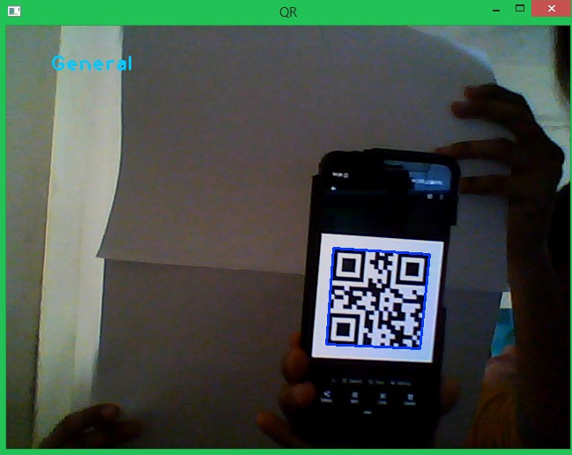
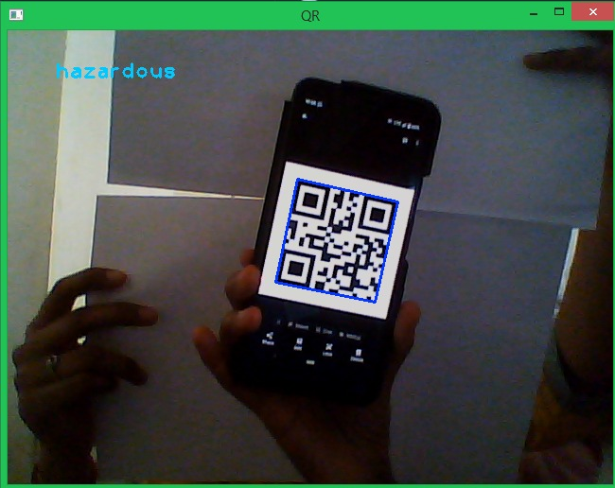
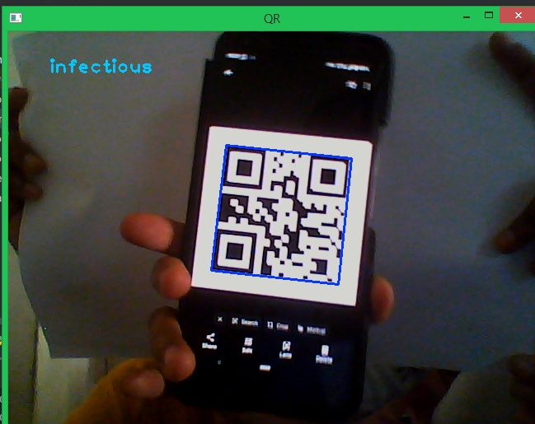
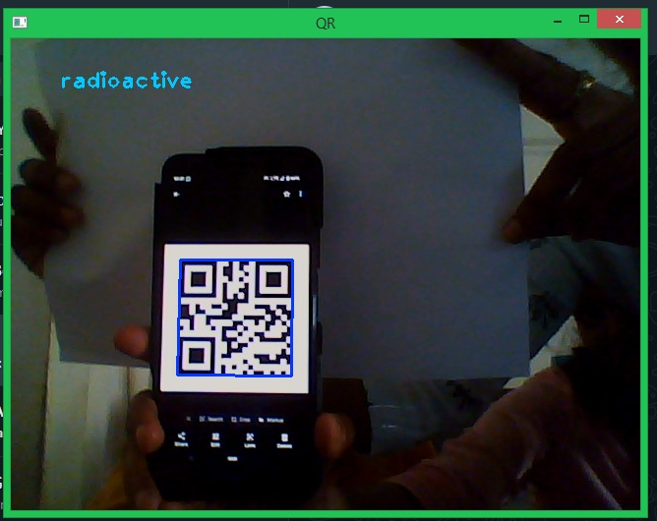
Implementation
Movement of Robotic arm
Real time object detection
Bin classification using QR code detection

Slide 15
IOT COMPONENTS:
Rasberry Pi
web Camera
Motor Driver
DC Motors
2 DoF Robotic arm
Waste Bins
Jumper wires
USB Cable
7.5V Lithium ion Battery

Slide 16
References
[1] Saravanamani, C.S., Subiksha, S., Suvetha, S., and Umamaheswari, S., “Automatic Bio Medical Waste Segregator”, In 2022 8th International Conference on Advanced Computing and Communication Systems (Vol. 1, pp. 1124-1130). IEEE.
[2] Avinash, N.J., Karthik, K., Krishnaraj Rao, N.S., Rama Moorthy, H., Santosh, S., “An Automated Robotic Arm: A Machine Learning Approach”, In 2021 IEEE International Conference on Mobile Networks and Wireless Communications. (pp. 1-6).
[3] Sawant, N., Sawant, S., Tyagi, A. and Tade, S.L., 2022, August. “Implementation of Faster RCNN Algorithm for Smart Robotic ARM Based on Computer Vision”. In 2022 6th International Conference On Computing, Communication, Control And Automation. (pp. 1-6). IEEE.
[4] Barik, H., Guru Prasad, Saroj Devi, Subbulaxmi., and Tulsi, K., "Automatic segregate: Dry and Wet segregation using CNN(Deep Learning) with Robotic arm", in the transaction on 2021 International Journal of Creative Research Thoughts,Vol:9, pp. 2320-2882.
[5] Madan, G., Prakash, K.R., Ravi Krishna, G., Ranjitha, S.R., “Automation of Object Segregation”, International Research Journal of Engineering and Technology, Vol:06, pp. 2395-0072.
[6] Bhoomika P.M., Sangeetha S, Sonika, Suma B, Vismitha S, "Automatic segregation of waste using Robotic Arm", in the transaction on 2021 International Journal of Creative Research Thoughts, Vol:7, pp. 3994-3999.
[7] Arpitha, Y., Isaac, P., Meghana, S., Naga Ravali, U., Tiny Sameera, N., “Waste Segregation System Using Robotic Arm ”, proceeding with journal Journal of engineering, computing & architecture, Vol:12 , pp. 1934-7197.

Slide 17
[8] L. Binyan, Z. Hebin, W. Yanbo, L. Yu, and C. Zhihong, "A vision-based robotic grasping system using deep learning for garbage sorting," in proceeding with 2017 36th Chinese Control Conference, 2017, pp. 11223-11226, doi: 10.23919/ChiCC.2017.8029147.
[9] Arshad, H., Islam, M.S., Islam, M.T. and Sallang, N.C.A., “A CNN-Based Smart Waste Management System Using TensorFlow Lite and LoRa-GPS Shield in Internet of Things Environment”, 2021 IEEE Access, 9, pp.153560-153574.
[10] Mahetalia, J., Mehta, R., Parmar, H., Samdani, K., and Varudandi, S., “A smart waste management and segregation system that uses internet of things, machine learning and android application”, In 2021 6th International Conference for Convergence in Technology (pp. 1-6). IEEE.
[11] Ghatge, S., Gurnani, K., Hatekar, A., Khairnar, M., and Mandgi, S., "Object Detection And Tracking Using Image Processing", in the transaction on Journal of Engineering Research and Application (2248-9622), 8(2).

Slide 18
Thank you

